Slide 1
CAMEL Rating System

Slide 2
Contents of this Presentation
01
02
03
04
Objectives
Purpose of this Study
Model Approach and Research Methodology
Data Visualisation

Slide 3
Introduction
Due to its role in risk management, financial intermediation, and economic growth, the banking sector is a crucial component of every contemporary economy.
In the past few years, Private banks in India have outperformed public banks due to their focus on specialized markets and technology.
Public banks have struggled with high levels of non-performing assets and are going through a period of transformational changes..
In order to secure their long-term viability and prosperity, banks must manage their finances responsibly and constantly evaluate their financial performance.
The CAMEL rating system is a well-known system used by regulatory bodies to evaluate the financial health of banks.
It is useful for evaluating the performance and strategic planning of Indian banks.

Slide 4
Objectives of this study
The CAMEL Model, a new breakthrough in the field of evaluating the financial performance of banks, is the research tool employed for the current study.
This study aims to understand how the CAMEL rating system will help the Indian banking system and its intricate details.
Selected five government and five private banks that are subjected for the analysis are:
Private Sector:
Axis Bank, HDFC, ICICI, Kotak Mahindra, and Yes Bank
Public Sector:
Bank of Baroda, Bank of India, Punjab National Bank, SBI, and Union Bank of India

Slide 5
01
Camel Model Approach

Slide 6
Process of rating banks using the CAMEL rating system:
The rating system evaluates five components: Capital adequacy, Asset quality, Management quality, Earnings, and Liquidity.
Each component is assigned a rating of 1 to 5, with 1 being the highest rating and 5 being the lowest.
The regulator assigns an overall rating to the bank based on the weighted average of the component ratings.
An overall rating of 1 means the bank is in excellent financial health, while a rating of 5 means the bank is in poor financial health and may be subject to regulatory intervention.

Slide 7
C :
Capital Adequacy

Slide 8
Capital Adequacy:
Capital Adequacy measures a bank's ability to withstand losses and remain solvent.
A bank with a higher Capital Adequacy Ratio (CAR) is generally considered to be more financially stable and less likely to fail.
Regulators use the CAR to determine if a bank has enough capital to cover potential losses from its operations.
The ratios that we use are:
Capital Adequacy Ratio (CAR)
Advance to Asset Ratio
Total Liability / Shareholders Fund
Total Liability / Total Equity
Tier 1%
Tier 2%

Slide 9
A :
Asset Quality

Slide 10
Asset Quality Ratio :
Asset quality refers to the composition and condition of a bank's loan portfolio and other assets. It reflects the creditworthiness and risk associated with the assets held by the bank.
Evaluating asset quality is essential for assessing a bank's financial health, profitability, and ability to manage credit risks effectively.
It reveals the kind of debtors the bank is dealing with and if a bank has lent high amount of credit to sectors that is bound to have problem with bad loan.
The ratios that we use are:
Net NPA to NEt Advances
Total Investments to Total Assets
Net NPA to Total Assets
Gross NPA to Total Assets

Slide 11
M :
Management Capacity

Slide 12
Management Capacity :
Management Capacity refers to a bank's ability to manage its operations effectively, make sound business decisions, and implement effective risk management practices.
It helps regulators to identify potential weaknesses in a bank's management and governance structures that could impact its safety and soundness.
The ratios that we use are :
Business per Employee
Profit per Employee
Return on Assets
Return on Equity

Slide 13
E :
Earning Quality

Slide 14
Earning Quality :
Earning Quality refers to a bank's ability to generate and sustain earnings over time.
It helps regulators to identify potential weaknesses in a bank's earnings performance that could impact its safety and soundness.
The ratios that we use are:
Operating Profit to Total Assets
Interest Income to Total Income Ratio

Slide 15
L:
Liquidity

Slide 16
Liquidity :
Earning Quality refers to a bank's ability to generate and sustain earnings over time.
It helps regulators to identify potential weaknesses in a bank's earnings performance that could impact its safety and soundness.
The ratios that we use are:
Operating Profit to Total Assets
Interest Income to Total Income Ratio

Slide 17
02
Data Visualization

Slide 18
02.1
Public Banks

Slide 19
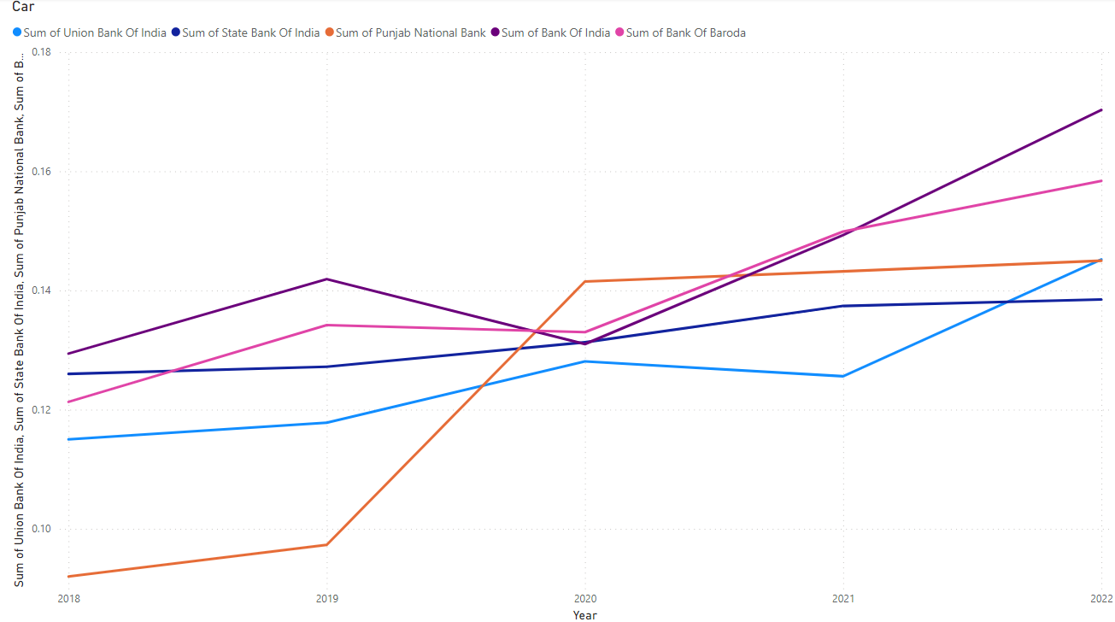
Capital Adequacy Ratio: Public Sector

Slide 20
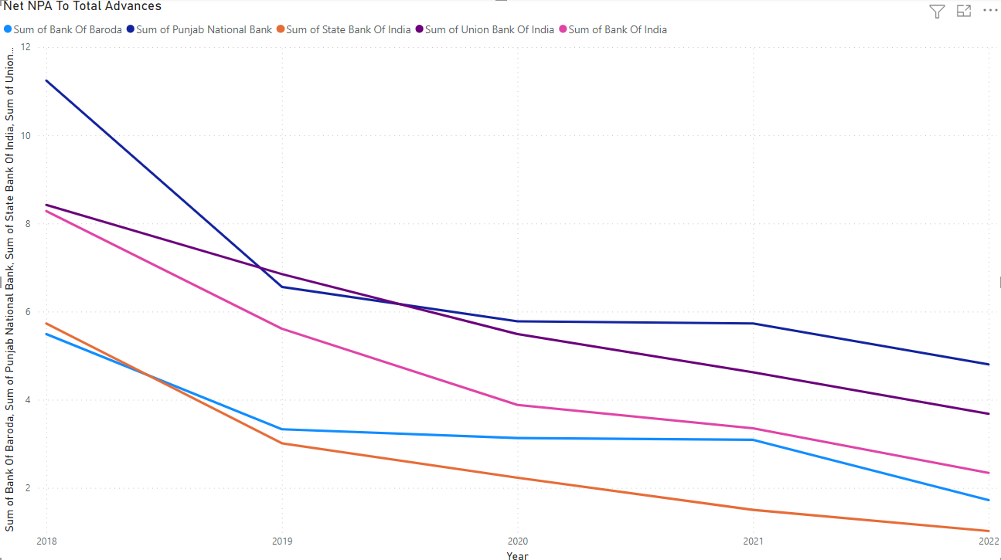
Asset Quality Ratio: Public Sector

Slide 21
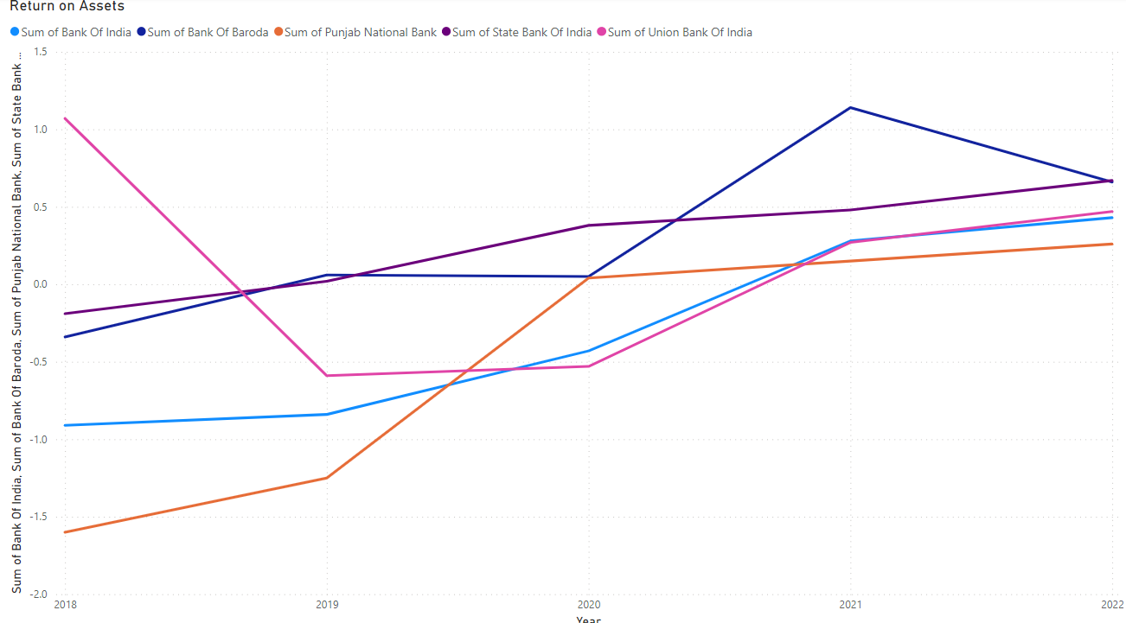
Management Quality Ratio: Public Sector

Slide 22
Earning Capital Ratio: Public Sector

Slide 23
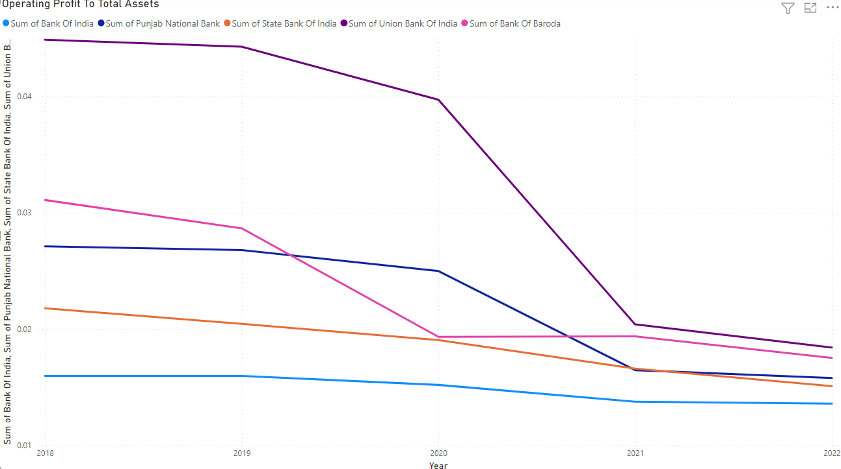
Earning Capital Ratio: Public Sector

Slide 24
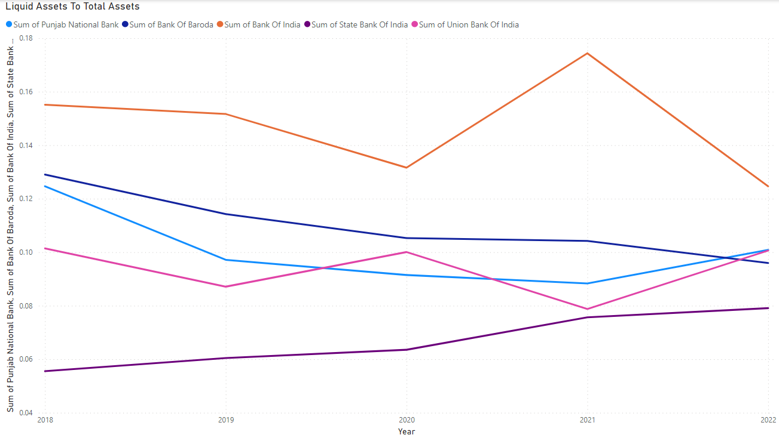
Liquidity Ratio: Public Sector

Slide 25
02.2
Private Banks

Slide 26
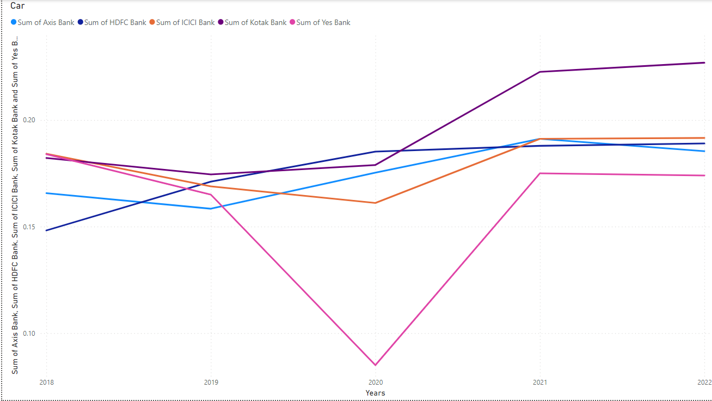
Capital Adequacy Ratio: Private Sector

Slide 27
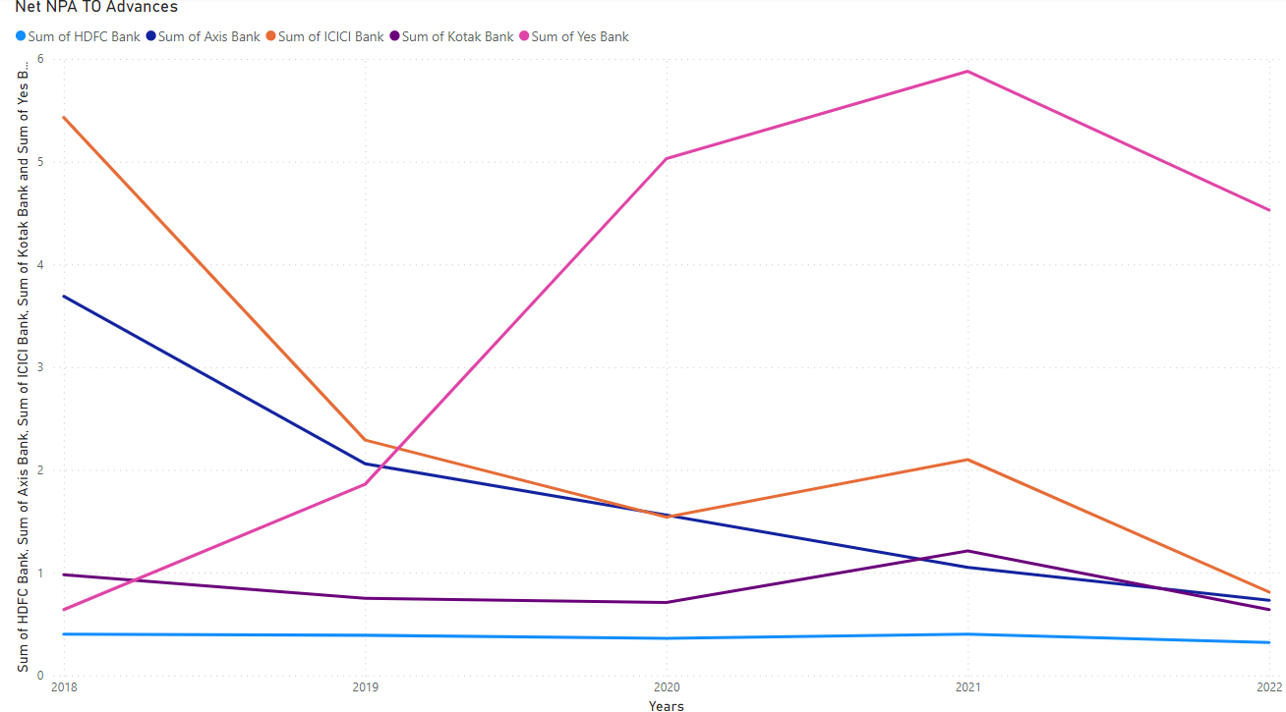
Asset Quality Ratio: Private Sector

Slide 28
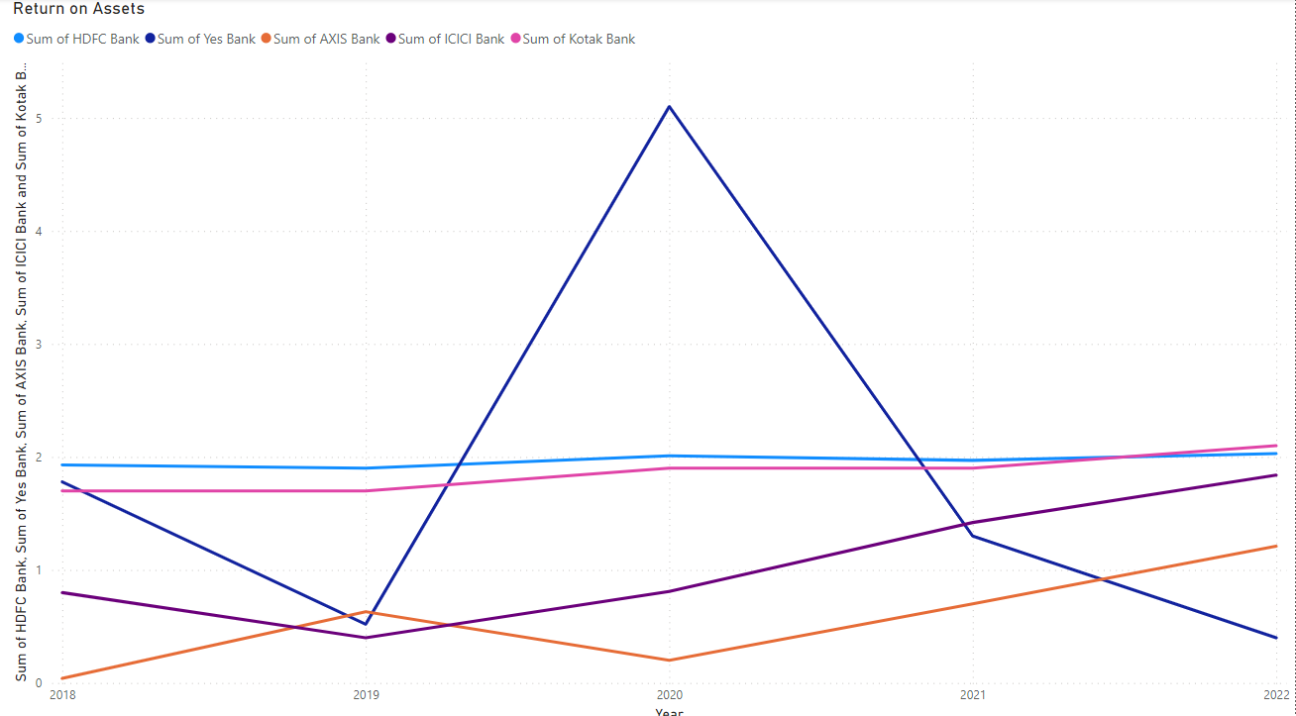
Management Quality Ratio: Private Sector

Slide 29
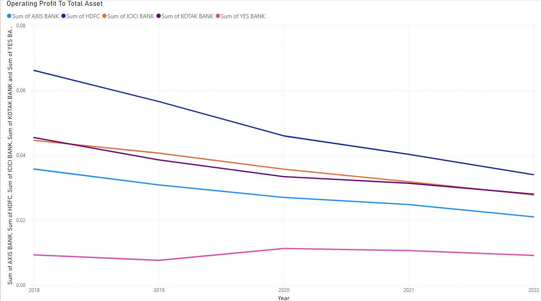
Earning Capital Ratio: Private Sector

Slide 30
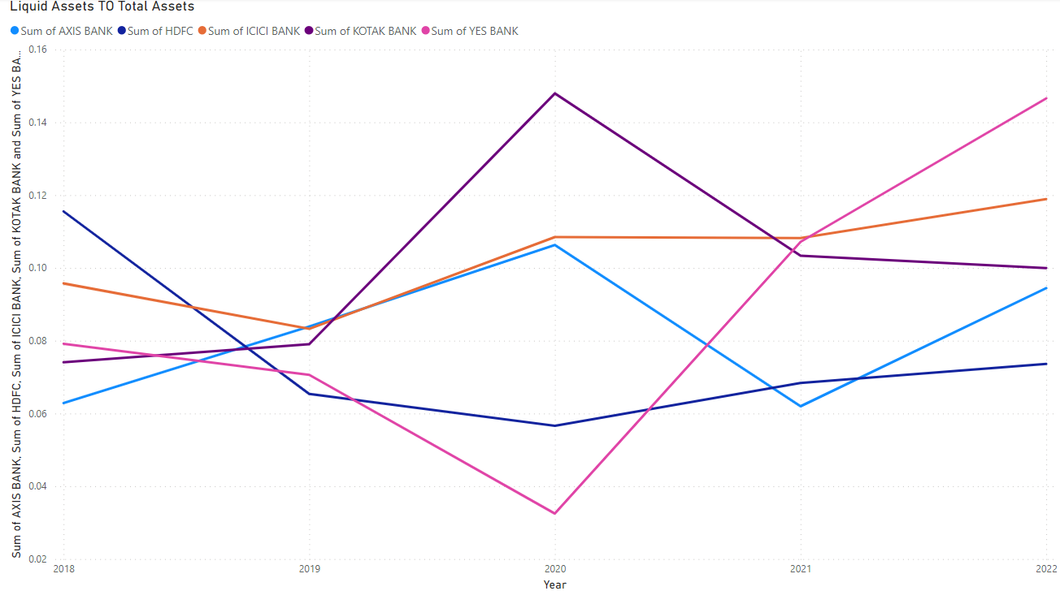
Liquidity Ratio: Private Sector

Slide 31
03
Final Ranking

Slide 32



Slide 34
03
Why is CAMEL Helpful?

Slide 35
CAMEL analysis provides a standardized framework for evaluating a bank's financial condition and risk profile.
Helps regulators to identify potential weaknesses in a bank's operations, risk management practices, and governance structures.
Helps regulators to monitor compliance with laws and regulations and take corrective action when necessary to protect depositors and maintain financial stability.
Provides a benchmark for comparing the safety and soundness of different banks and identifying outliers that may require closer scrutiny.
Therefore, CAMEL analysis is an important tool for promoting financial stability and protecting the interests of depositors and other stakeholders in the banking system.

Slide 36
04
Limitations of this study

Slide 37
CAMEL analysis is based on a set of financial ratios and other quantitative measures, which may not capture all relevant aspects of a bank's operations or risk profile.
It’s is a point-in-time assessment and may not capture changes in a bank's risk profile or financial condition over time.
May not reflect the views or opinions of other stakeholders, such as investors or customers.
May not capture non-financial factors, such as reputation or brand risk, which can have a significant impact on a bank's safety and soundness.
Therefore, while CAMEL analysis is a useful tool for assessing the safety and soundness of a bank, it should be used in conjunction with other sources of information and analysis to provide a more comprehensive view of a bank's operations and risk profile.

Slide 38
05
Conclusion

Slide 39
Final Ranking:
Private Bank | Total | Ranking
Axis | 65 | 5
HDFC | 43 | 1
ICICI | 52 | 3
Kotak | 51 | 2
Yes Bank | 59 | 4
Public Ranking | Total | Ranking
Bank of baroda | 35 | 1
Bank of India | 45 | 2
Punjab National Bank | 59 | 5
SBI | 55 | 3
Union Bank Of India | 58 | 4

Slide 40
Our team
Aniket Kindre
Drishti Chulani
Roll No: 12
aniket.kindre@sdbi.in
Roll No: 03
drishti.chulani@sdbi.in
Sahil Raorane
Ovi Jadhav
Roll No: 08
sahil.raorane@sdbi.in
Roll No: 14
ovi.jadhav@sdbi.in

Slide 41
Thank You!! :)
Questions?

